Slide 1
ON -> DOOR
All doors closed, key removed
ON -> OFF
Switch : ON
Light ON
OFF -> ON
Switch : OFF
Light OFF
1
DOOR -> OFF
1
2
OFF -> DOOR
At least 1 door open or key inserted
3
4
Switch : DOOR
Light ON
Close all doors
Remove key
Switch : DOOR
Light OFF
Open at least 1 door
Or insert key at door lock
DOOR -> ON

Slide 2
1 : ON -> DOOR, At least one of the doors open, or key is inserted.
2 : DOOR -> OFF
3 : OFF -> DOOR, All doors closed, and key not inserted.
4 : DOOR -> OFF

Slide 3
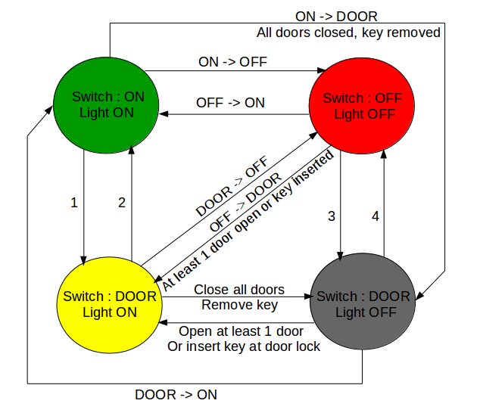
1 : ON -> DOOR, At least one of the doors open, or key is inserted.
2 : DOOR -> OFF
3 : OFF -> DOOR, All doors closed, and key not inserted.
4 : DOOR -> OFF

Slide 4
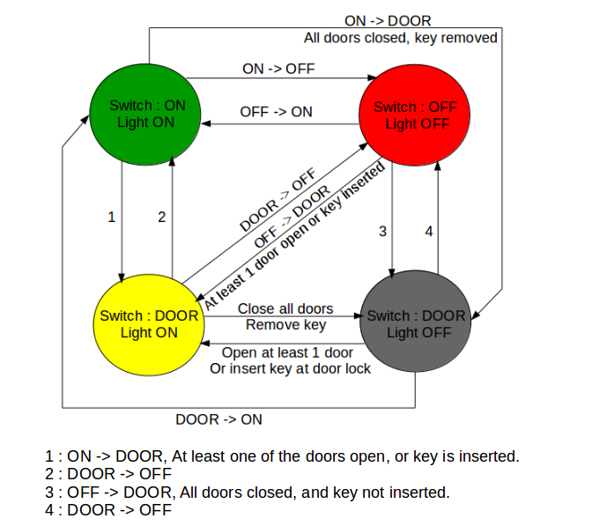
INTERNAL LIGHT

Slide 5
Switch off Indicators
Left -> Right
Left Indicator
ON
Right -> Left
Right Indicator
ON
1
Turn On right Indicator
1
2
Turn On Breakdown indicator
3
4
Breakdown
Indicator ON
Indicators
OFF
Switch off Indicators
Turn On Breakdown
Indicator
Switch on left indicator

Slide 6
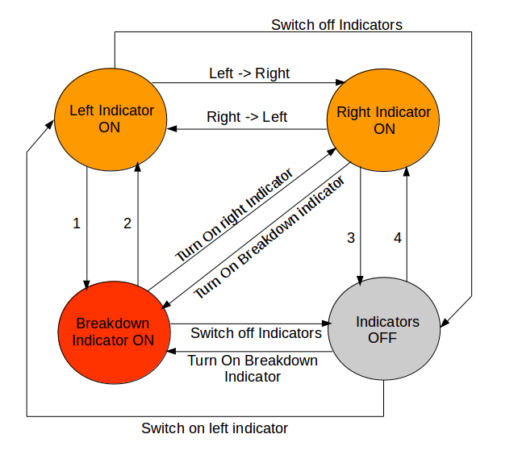
1 : Turn On Breakdown Indicator
2 : Turn On left Indicator
3 : Switch Off Indicators
4 : Turn On Right Indicators

Slide 7
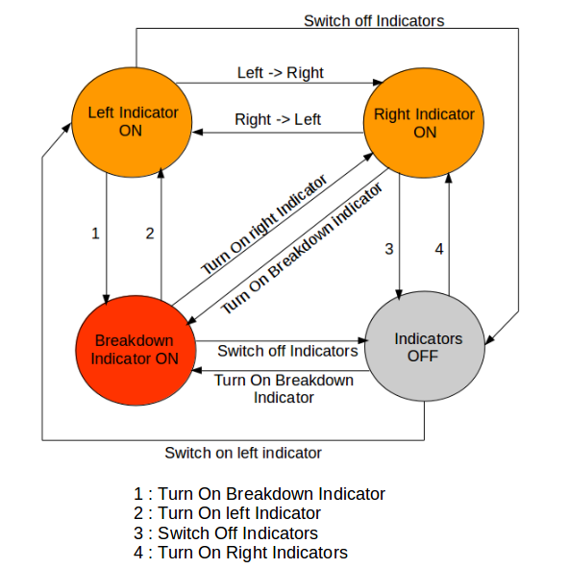
EXTERNAL LIGHTS

